Slide 1
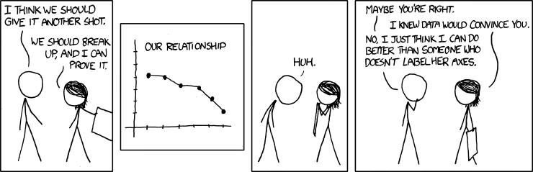
Univariate Regression
Geog4300/6300
Jerry Shannon

Slide 2
Your final project format?
Research questions:
What is the evidence of gerrymandering (packing/cracking) in each year? How is it different across years?
Variables:
Race (tract level), Income (tract level), Voting
Analysis:
Descriptive stats and geographical distribution for each variable in each year. Location quotient? T tests?
Correlation of race/income (% of tracts that are x% nonwhite, >20% poverty, etc.) and voting
Calculate efficiency gap in each year

Slide 3
Variablesc | Tests; test statistics; SE
Continuous; one sample: σ known and n > 30 OR data is a proportion | One-sample z-test; Z; SE = σ/sqrt(n); OR Diff. of proportions
Continuous; one sample: σ unknown or n < 30 | One-sample t-test; t; SE = s/sqrt(n-1)
Continuous; two samples | Student’s t-test for difference of means
Continuous; paired samples | Paired t-test
Continuous; more than two samples | ANOVA
Discrete; two variables; counts | Chi-square, goodness of fit
Continuous; two or more variables | Correlation
Continuous; two or more variables | Regression
You are here

Slide 4
Simple (univariate) regression
Assesses the effect of one variable (x) on another (y)
Multivariate regression
Assesses the effect of several variables (x₁, x₂, x₃, etc.) on a single y

Slide 5
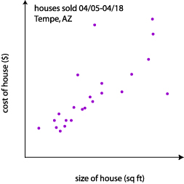
Correlation
tells us how strongly x and y are related
Regression
tells us how a change in x is associated with a change in y
Correlation:
There is a strong positive relationship (r=0.81) between the size of a house and its selling price.
Regression:
The price of a house goes up $10,000 for each additional 500 square feet.

Slide 6
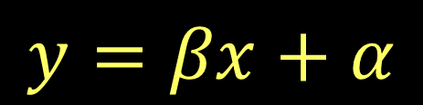

Regression creates a linear model, an equation based line that allows for prediction.
Another kind of model…

Slide 7
Assumptions of regression:
Independent observations
Dependent variable is normal and ratio/integer
Linear relationship between variables
Normality and homogeneous variance of residuals (error)
Uncorrelated independent variables (No multicollinearity)
Lack of outliers

Slide 8
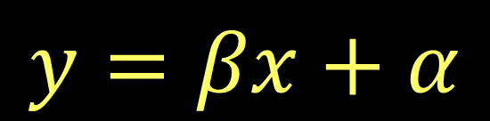
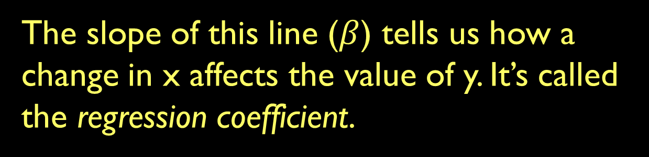
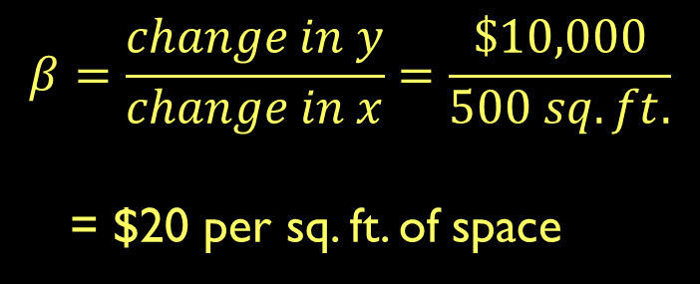
$10K
500 sq. ft

Slide 9

$10K
500 sq. ft

Slide 10
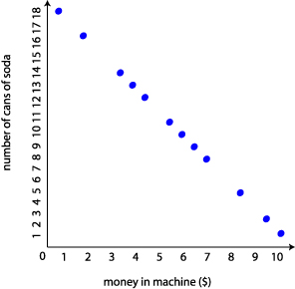
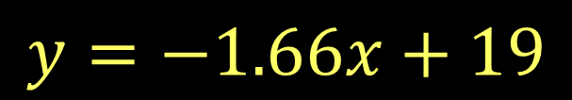
What is r?
What is β?
What is α?
How would you interpret this equation?

Slide 11
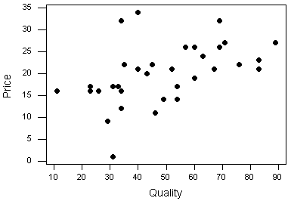
What if the data isn’t so clearly linear?
How do we draw our regression line?

Slide 12
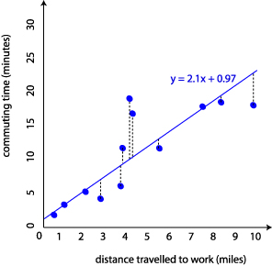
The “best fit” regression line:
Draw a line that minimizes the distances from points to the line
The dotted black lines are the residuals.
What might account for them?

Slide 13
The “best fit” regression line:
Draw a line that minimizes the distances from points to the line
To determine this line, the residuals are squared and then summed. The line with the smallest total is the one you use.

Slide 14
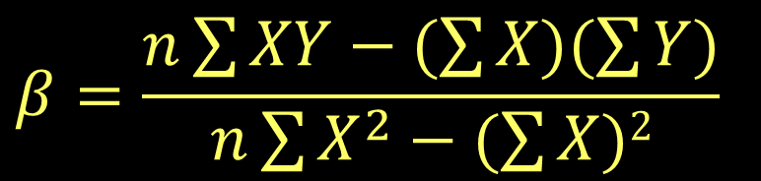
Calculating your regression line
(You almost always use software to do this, but…)
The sum of X and Y respectively
The sum of products of X and Y
Neighborhood | Median age | Number of gardens
1 | 43 | 99
2 | 21 | 65
3 | 25 | 79
4 | 42 | 75
5 | 57 | 87
6 | 59 | 81

Slide 15
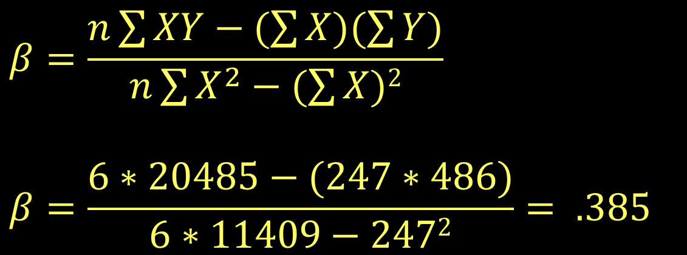
Calculating your regression line
Neighborhood | Median age | Number of gardens | X² | XY
1 | 43 | 99 | 1849 | 4257
2 | 21 | 65 | 441 | 1365
3 | 25 | 79 | 625 | 1975
4 | 42 | 75 | 1764 | 3150
5 | 57 | 87 | 3249 | 4959
6 | 59 | 81 | 3481 | 4779
Total | 247 | 486 | 11409 | 20485

Slide 16
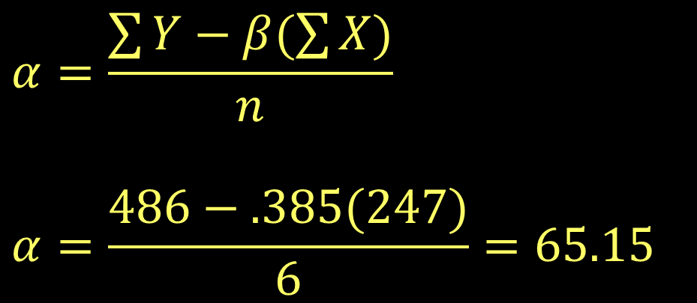
Calculating your regression line
Neighborhood | Median age | Number of gardens | X² | XY
1 | 43 | 99 | 1849 | 4257
2 | 21 | 65 | 441 | 1365
3 | 25 | 79 | 625 | 1975
4 | 42 | 75 | 1764 | 3150
5 | 57 | 87 | 3249 | 4959
6 | 59 | 81 | 3481 | 4779
Total | 247 | 486 | 11409 | 20485

Slide 17
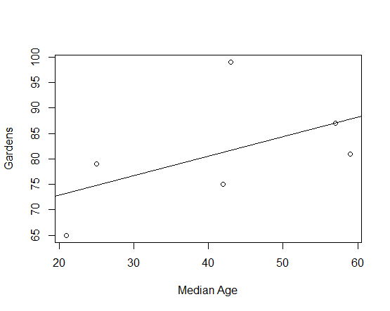
Calculating your regression line
Y= 0.385x + 65.15
Neighborhood | Median age | Number of gardens | X² | XY
1 | 43 | 99 | 1849 | 4257
2 | 21 | 65 | 441 | 1365
3 | 25 | 79 | 625 | 1975
4 | 42 | 75 | 1764 | 3150
5 | 57 | 87 | 3249 | 4959
6 | 59 | 81 | 3481 | 4779
Total | 247 | 486 | 11409 | 20485

Slide 18
Interpreting the coefficient
W
Y= 0.385x + 65.15
Each year of increase in median age in the neighborhood is associated with 0.385 more gardens.
Neighborhood | Median age | Number of gardens | X² | XY
1 | 43 | 99 | 1849 | 4257
2 | 21 | 65 | 441 | 1365
3 | 25 | 79 | 625 | 1975
4 | 42 | 75 | 1764 | 3150
5 | 57 | 87 | 3249 | 4959
6 | 59 | 81 | 3481 | 4779
Total | 247 | 486 | 11409 | 20485

Slide 19
Interpreting the coefficient
W
Y= 0.385x + 65.15
What does that mean in our dataset? Use range of actual median age.
What’s the difference in age between neighborhoods 2 and 5?
What’s the predicted difference in gardens based on our model?
Neighborhood | Median age | Number of gardens | X² | XY
1 | 43 | 99 | 1849 | 4257
2 | 21 | 65 | 441 | 1365
3 | 25 | 79 | 625 | 1975
4 | 42 | 75 | 1764 | 3150
5 | 57 | 87 | 3249 | 4959
6 | 59 | 81 | 3481 | 4779
Total | 247 | 486 | 11409 | 20485

Slide 20
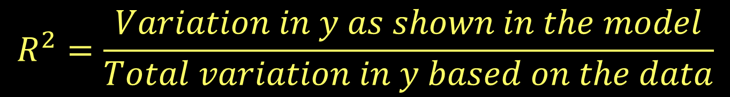
How good is the model fit?
R² is the proportion of variance in the data explained by your model:
the “coefficient of determination.”
We won’t go over how it’s calculated, but the rough version is this (see p. 256-258 for more info):

Slide 21
Y= 0.385x + 65.15
This model has an R² of .2807.
That means it explains about 28% of the total variation in gardens between neighborhoods
(That’s not very good.)
Neighborhood | Median age | Number of gardens | X² | XY
1 | 43 | 99 | 1849 | 4257
2 | 21 | 65 | 441 | 1365
3 | 25 | 79 | 625 | 1975
4 | 42 | 75 | 1764 | 3150
5 | 57 | 87 | 3249 | 4959
6 | 59 | 81 | 3481 | 4779
Total | 247 | 486 | 11409 | 20485

Slide 22
Model fit is also calculated through ANOVA
Neighborhood | Median age | Number of gardens | Predicted gardens | Difference
1 | 43 | 99 | 81.7 | 17.3
2 | 21 | 65 | 73.2 | -8.2
3 | 25 | 79 | 74.8 | 4.2
4 | 42 | 75 | 81.3 | -6.3
5 | 57 | 87 | 87.1 | -.1
6 | 59 | 81 | 87.1 | -6.9
Total | 247 | 486
Is the model based on these variables a better predictor of the dependent variable than an “intercept only” model with just the constant?

Slide 23
Model fit is also calculated through ANOVA
Neighborhood | Median age | Number of gardens | Predicted gardens | Difference
1 | 43 | 99 | 81.7 | 17.3
2 | 21 | 65 | 73.2 | -8.2
3 | 25 | 79 | 74.8 | 4.2
4 | 42 | 75 | 81.3 | -6.3
5 | 57 | 87 | 87.1 | -.1
6 | 59 | 81 | 87.1 | -6.9
Total | 247 | 486
What’s the variance of these two groups relative to the mean of y (81)?
This is calculated by squaring and summing two things: 1) Diff. of predicted values and the mean (variance between groups)
2) Diff. of predicted values and actual values (variance within groups)

Slide 24
Model fit is also calculated through ANOVA
Neighborhood | Median age | Number of gardens | Predicted gardens | Difference
1 | 43 | 99 | 81.7 | 17.3
2 | 21 | 65 | 73.2 | -8.2
3 | 25 | 79 | 74.8 | 4.2
4 | 42 | 75 | 81.3 | -6.3
5 | 57 | 87 | 87.1 | -.1
6 | 59 | 81 | 87.1 | -6.9
Total | 247 | 486
What’s the variance of these two groups relative to the mean of y (81)?
This is calculated by squaring and summing two things: 1) Diff. of predicted values and the mean (variance between groups)
2) Diff. of predicted values and actual values (variance within groups)

Slide 25
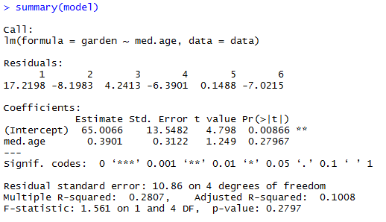
Regression in R

Slide 26
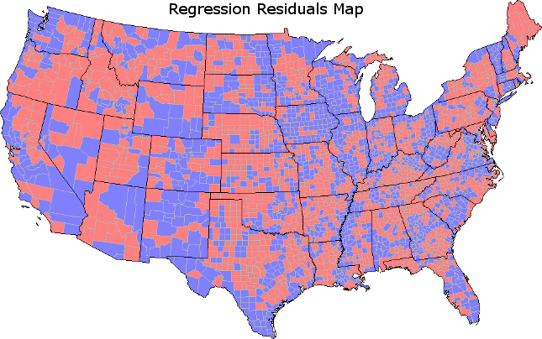
Model Diagnostics
Examine normality of model residuals
Examine the spatial distribution of residuals

Slide 27
Residuals matter!
Neighborhood | Median age | Number of gardens | Predicted gardens | Difference
1 | 43 | 99 | 81.7 | 17.3
2 | 21 | 65 | 73.2 | -8.2
3 | 25 | 79 | 74.8 | 4.2
4 | 42 | 75 | 81.3 | -6.3
5 | 57 | 87 | 87.1 | -.1
6 | 59 | 81 | 87.1 | -6.9
Total | 247 | 486
Where are residuals especially high?
What might account for that difference?

Slide 28
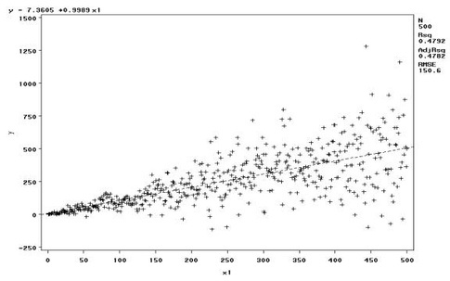
Model Diagnostics
Examine normality of model residuals
Examine the spatial distribution of residuals
Assess the impact of outliers
Look for heteroskedasticity

Slide 29

Oh, no! My model has issues!
Look for possible causes/missing variables
Transform variables (log is most common)
For heteroskedastic models, see https://www3.nd.edu/~rwilliam/stats2/l25.pdf

